Slide 1
Big Mountain Ski Resort
Pricing and Ski Feature Development Strategy

Slide 2
Problem
Ticket Price Strategy – Currently Big Mountain has an Adult Weekend Ticket price of $81.00 per Day compared to the average US Adult Weekend Ticket price of $63.81.
Is there room to increase the price?
If so, by how much?
Which features contribute the most to ticket price?
By how much?
Feature Development Strategy – Which features of the ski resort should be developed and invested in and which should be cut.
Runs
Snowmaking
Skiable Terrain, etc.

Slide 3
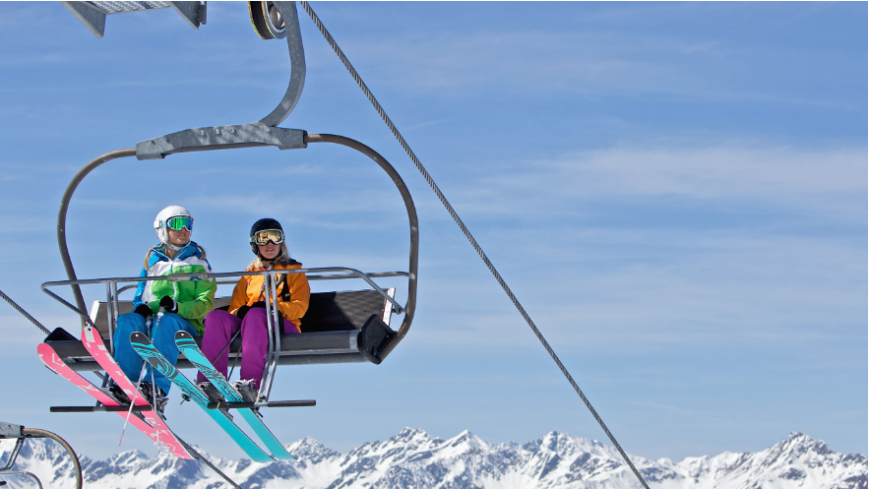
Recommendations
Close six of its least utilized ski runs.
Increase the Vertical Drop of the Resort by adding a 150 foot run at the bottom of the skiable terrain.
Install a chair lift to service the lower run.

Slide 4
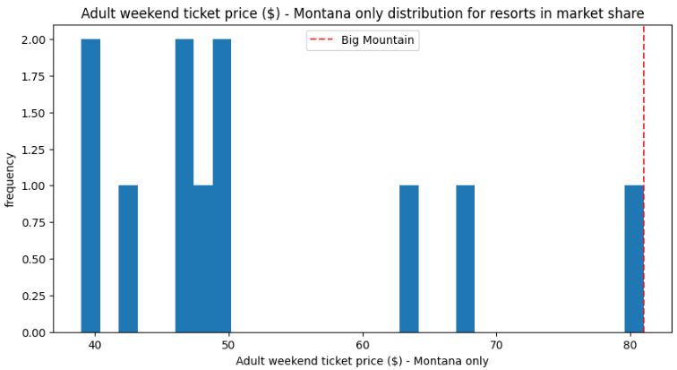
Price Market
Big Mountain is at the top of the MT Ski Resort Price Point
Utilizing our model to analyze ski resort pricing data we found that Big Mountain had a modelled price of $95.87 with an error of give or take $10.39.
If Big Mountain erred on the conservative side and subtracted the error of $10.39 from the modelled price a possible price increase of up to $85.87 is feasible.

Slide 5
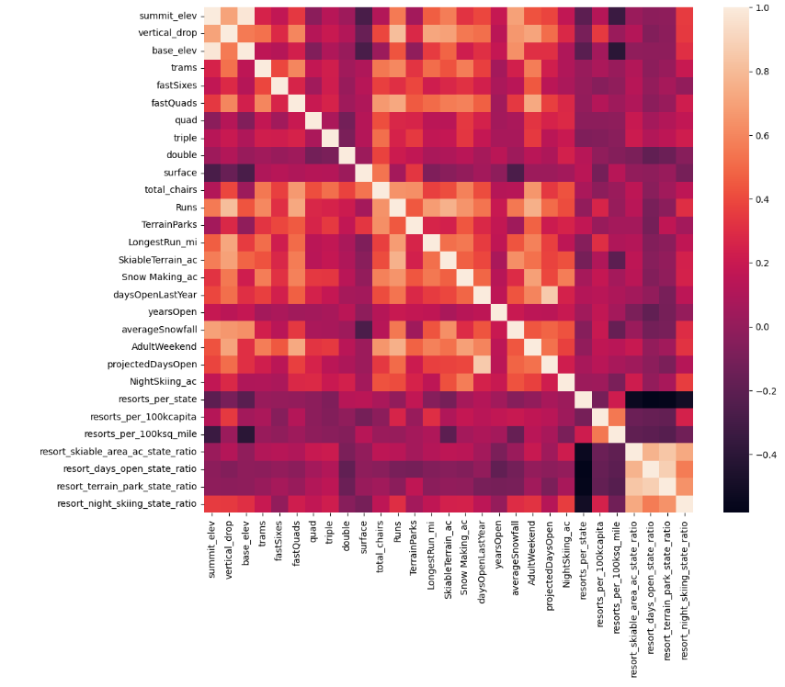
Price Correlation
Pricing was derived from Correlations found between ski resort features of the US and their relationship to price.
The highest correlated items were:
Vertical Drop
Snow Making
Runs
Fast Quads
Total Chairs

Slide 6
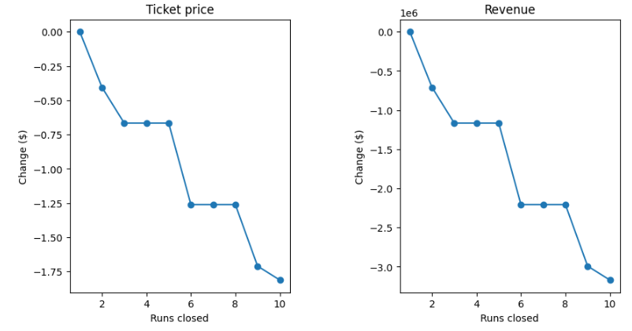
Price Amounts – Key Findings
When runs were modelled we found that price decreases change with number of runs closed but not evenly.
A close of five runs would decrease ticket price by $0.70 per ticket.
Also adding 150’ to the vertical drop would increase resort pricing by $1.99 per ticket.

Slide 7
Summary
Open a lower run that extends the vertical drop by 150’.
Close 6 less used runs for a net run closure of 5 runs.
Install a new chair lift for the new run at a cost of $1.54M.
Increase the Adult Weekend Ticket price by $1.29 ($1.99 Vertical Drop Increase – 5 run closures at $0.70) that is still below the modelled conservative threshold of $85.87.
The additional Revenue from the increased ticket price of $2.25M would easily offset the cost of a new chair lift of $1.54M.
All of these changes theoretically won’t lose any current customers but may actually capture more with the new vertical drop extension, plus the cost of five runs decreases operational expenses!

